Slide 1
Elasticsearch short introduction
Jakub Gwoźdź

Slide 2
https://github.com/jakubgw/elasticsearch-short-intruduction
Docker compose with
elasticsearch cluster working on two nodes
Kibana plugin
Sample data collections to insert
Postman collection with all calls
This presentation
Use readme.md as a starting point

Slide 3
Elasticsearch is a highly scalable open-source full-text search and analytics engine. Allows you to store, search, and analyze big volumes of data quickly and in near real time.
http://elastic.co/
Notes:
As you will continue to use both your Avanade and Infusion accounts for some period of time, you must also ensure that you are using good password hygiene on your Infusion account. Make sure your Infusion account password is set to one that is not used anywhere else. You may choose to use/sync your new, strong Avanade password or passphrase on your Infusion account to have one corporate password so long as this password is not used anywhere else, though ideally this would be different as well.

Slide 4
Example uses cases
NoSQL database + fulltext search – ex. web store that provides near to realtime search for whole inventory
Log analize and mining, check for trends, statistics, summarizations, or anomalies. Search + aggregations
Analitics and bussiness inteligance - quick investigation, analyze and visualization milions or bilons of records. Elastic + kibana, plugin which works on top of the index and provides visulization capabilities
Spatial queries, search for the nearest point, search for the polygons which contains point, create cluster aggregations

Slide 5
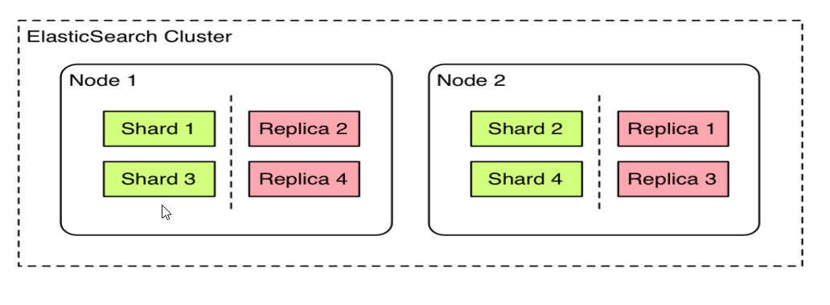
Architecture – basic concepts
A cluster is a collection of one or more nodes (servers) that together holds entire data and provides indexing and search capabilities across all nodes.

Slide 6
Architecture – basic concepts
Index – single collection of documents
Shard - index can be bigger than one server
shards solve problem of horizontal scalling
allsows distribute and paralize
Under the hood each shard is a Lucene index
Replica – copy of the shard
provides high avability, if any shard fail
allows scale out search throughput - searches can be executed on all replicas in parallel.

Slide 7
Full text search – demo
Shakespere index – contains dialogs for 36 plays
How to find „to be or not to be” dialouge in ~ 20 miliseconds
POST /shakespeare/_search?size=10
HTTP/1.1Host: localhost:9200
Content-Type: application/json
{
"query": {
"match": {
"text_entry": "to be or not to be"
}
}
}

Slide 8
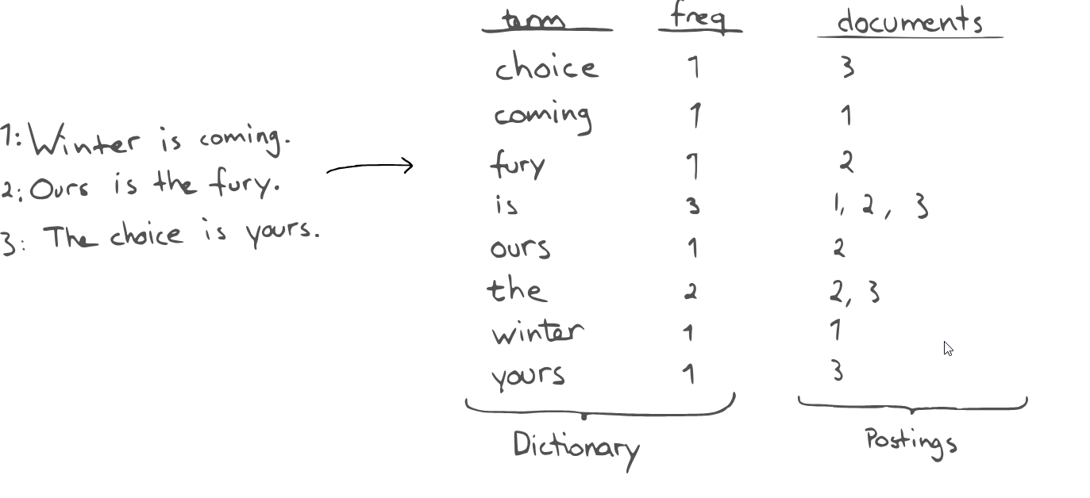
Inverted index
Data structure at the heart of the each search algorithm, hashmap that directs from the word to the document index

Slide 9
Inverted index
Get the document
Tokenize text into single worlds
Normalize, lowercase, remove punctioations, special characters and other noises
Analize worlds, depends on needs for example :
To find endinds reverse "fantastic" → "citsatnaf„
To find substrings build n-grams „ yours" → "^yo", "you", "our", "urs", "rs$„
To finds cooridante points create heo hashes (60.6384, 6.5017) → „u4u8gyykk”
Sort and put into dictionary

Slide 10

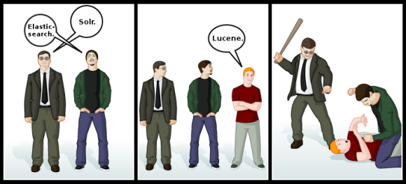
Apache Lucene
Elasticsearch uses apache lucene as inverted index

Slide 11
Scoring calculations
Inverted index is used for finding documents but also scorring calculation – to put results in the correct order
Term Frequency - how often does the term appear in this document ? more often, score is higher
Inverse Document Frequency - how often does each term appear in all documents in the index? The more often, score is lower
Field-length norm – how long is the field? The longer it is, the less likely it is that words in the field will be relevant
Use explain query paramter to get details
localhost:9200/shakespeare/_search?explain=true

Slide 12
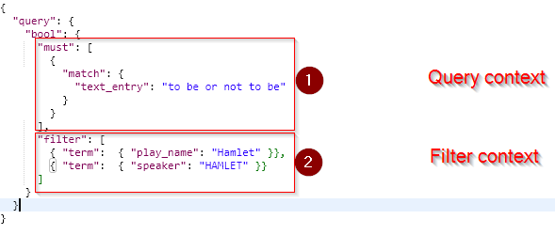
Speed up search – filters
Produces boolean outcome, without scorring
Frequently used for filtering structured data, like single terms, ranges etc
If request contains query and filters
First filters are applied
After it, on data which left, query with scorring is applied
Frequently used filters are cached

Slide 13
Near to real time update
Elasticsearch provides data manipulation and search capabilities in near real time.
We can expect a one second delay (refresh interval) from the time data are indexed/updated/deleted until the time that it appears in the search results.
Distinction from other platforms like SQL wherein data is immediately available after a transaction is completed.

Slide 14
Create Read Update Delete
Elastic expose plain REST API
Oficial client libraries for : Java, JavaScript, Groovy, .NET, PHP, Perl, Python, Ruby
Comunity libraries for : B4J, C++, Clojure, ColdFusion (CFML), Erlang, Go, Groovy, Haskell, Java,JavaScript, kotlin, Lua, .NET, Ocaml, Perl, PHP, Python, R, Ruby, Rust, Scala,Smalltalk,Vert.x

Slide 15
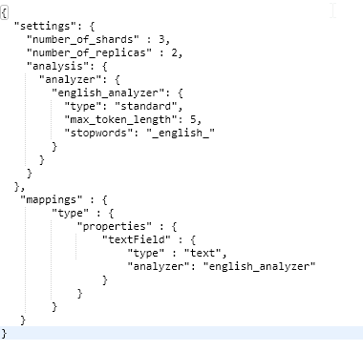
CRUD – create index
This is not obligatory, if you insert data to not existing collection it will create index automatically with default settings and mappings (based on inserted fields)
PUT /test HTTP/1.1
Host: localhost:9200

Slide 16
CRUD – create document
POST – auto generated id
PUT – option to manually create id
POST /test/type HTTP/1.1
Host: localhost:9200
Content-Type: application/json
{ "textField" : "This is text field"}
PUT /test/type/thisisID HTTP/1.1
Host: localhost:9200
Content-Type: application/json
{ "textField" : "This is text field"}

Slide 17
CRUD - read documents
„bool” section – more complex queries
Previous full-text-search example was only syntax sugar over it
Using sort will null scoring
{
"query": {
"bool": {
"must": [],
"must_not": [],
"filter": [],
"should": [],
"minimum_should_match": 1
}
}
}

Slide 18
CRUD - read documents
GET and query string parameters – only Luceny query syntax
Search in the default _all field:
GET /_search?q=test
Complex search with operator and exact phrase search with boost:
GET /_search?q=title:(joli OR code) AND author:"Damien Alexandre"^2
Search with wildcard and special queries:
GET /_search?q=_exists_:title OR title:singl? noneOrAnyChar*cter
Search with fuzzyness and range:
GET /_search?q=title:elastichurch~3 AND date:[2016-01-01 TO 2018-12-31]

Slide 19
CRUD – delete document or index
Delete index
Delete document from index
DELETE /test/type HTTP/1.1
Host: localhost:9200
DELETE /test/type/thisisID HTTP/1.1
Host: localhost:9200

Slide 20
CRUD – update document
Almost the same like create
PUT - replace document
POST + _update – update document
PUT /test/type/thisisID HTTP/1.1
Host: localhost:9200
Content-Type: application/json
{
"textField": „This document will be replaced„
}
POST /test/type/thisIsId/_update HTTP/1.1
Host: localhost:9200
Content-Type: application/json
{
"doc" : {
"textField" : "This is text field 33"
}
}

Slide 21
Boost queries
We can have influence which part of the query are more imporant in scorring calculatation
Property „boost” has to be added to the query object
"match": {
"text_entry" : {
"boost": 2,
"query" : "To be, or not to be: that is the question:"
}
}

Slide 22
POST /_aliases { "actions" : [ { "remove" : { "index" : "test1", "alias" : "alias1" } }, { "add" : { "index" : "test2", "alias" : "alias1" } } ] }
Aliases
The index aliases API allows aliasing an index with a name, with all APIs automatically converting the alias name to the actual index name.
POST /_aliases
{
"actions" : [
{ "remove" : { "index" : "test1", "alias" : "alias-name" } },
{ "add" : { "index" : "test2", "alias" : "alias-name" } }
]
}

Slide 23
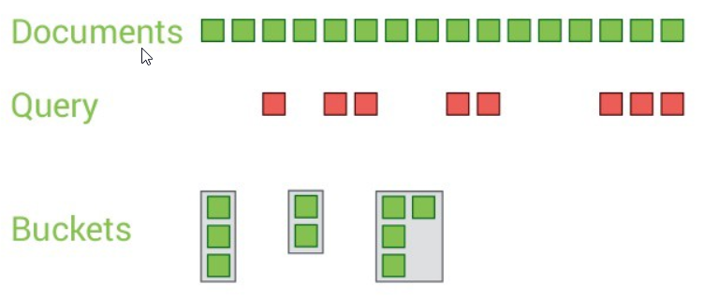
Aggregations
Freamwork which gives us an overview of our data.
It enables you to quickly calculate and summaries data that results from query
Two main concepts :
Buckets: It is a collection of documents that meet a certain criteria.
Metrics: It is statistics calculated on the documents in a bucket like sum, avg etc.

Slide 24
Aggregations - example
POST /shakespeare/_search?size=0 HTTP/1.1
Host: localhost:9200
{
"aggs" : {
„plays" : {
"terms" : {
"field" : "play_name",
"size" : 100
}
}
}
}

Slide 25
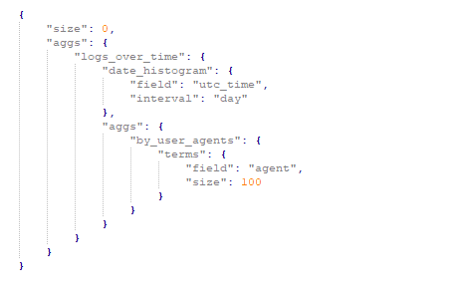
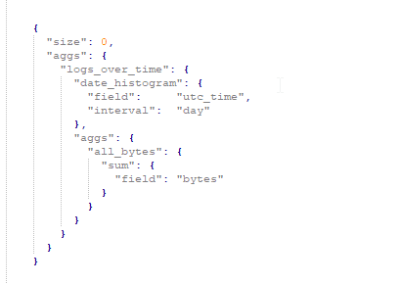
Aggregations over aggregated buckets

Slide 26
Find document with geo-shapes which either intersect, are contained by, or do not intersect with the specified geo-shape.
Find document with geo-shapes which either intersect, are contained by, or do not intersect with the specified geo-shape.
Geo queries – points
Geo pont can be saved in elasticsearch as a pair of numbers: latitude and longitude.
Following filters can help:
geo_distance - Finds document with geo-points within the specified distance of a central point.
geo_bounding_box - finds documents with geo-points that fall into the specified rectangle.
geo_polygon - finds documents with geo-points within the specified polygon.

Slide 27
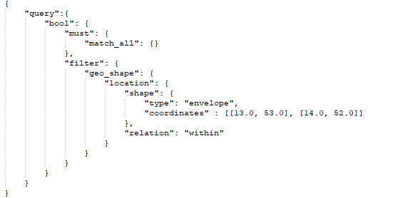
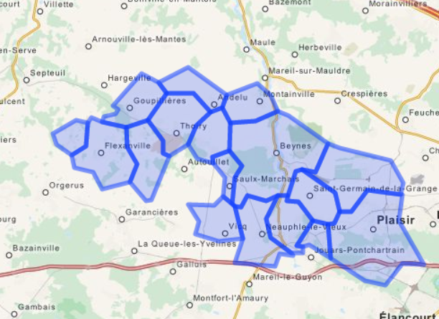
Geo queries – shapes
Finds documents with geo-shape, supports
INTERSECTS - (default) Return all documents whose geo_shape field intersects the query geometry.
DISJOINT - Return all documents whose geo_shape field has nothing in common with the query geometry.
WITHIN - Return all documents whose geo_shape field is within the query geometry.
CONTAINS - Return all documents whose geo_shape field contains the query geometr

Slide 28
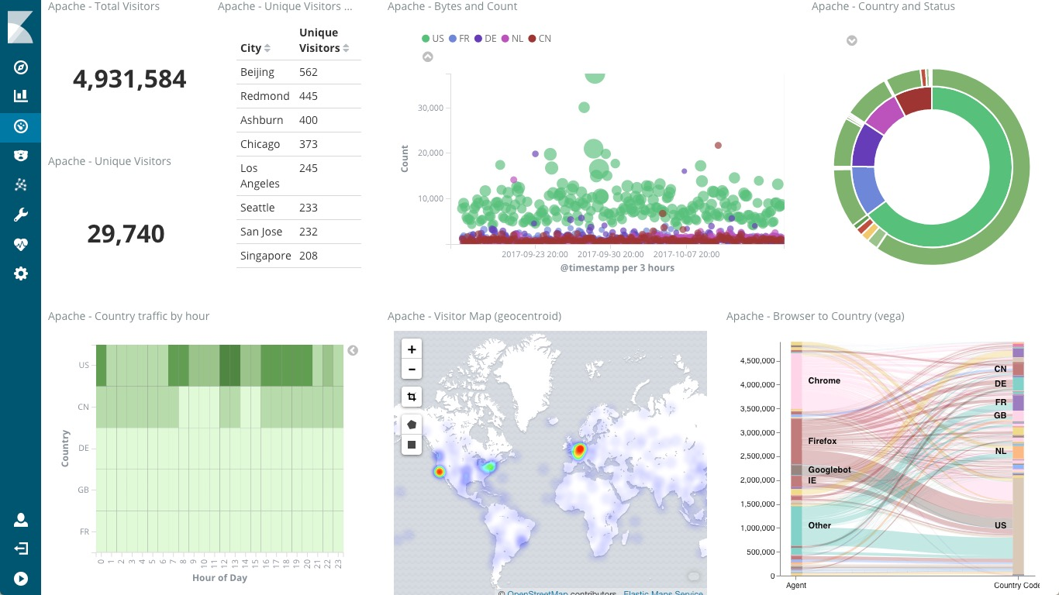
Kibana
Elasticsearch plugin with provides real time rich visualizations, reports, dashbords etc.
It can use our searches and queries as a data feed for visualizations

Slide 29
Not covered topics
Relationships
Nested queries – array inside of document which can be quried as seperate index
has_child query returns parent documents whose child documents match the specified query
has_parent query returns child documents whose parent document matches the specified query.
Logstash – collecting & processing logs from multiple sources
Suggestions – based on ngrams analyzers elastic can provide suggestions for the query
More advance analyzers
SQL Access – consumes SQL queries and produces results in the tables
Many more ☺

Slide 30
Any questions ?

